Slide 1
Version Control
Team Server

Slide 2
Team Server
When you create an app, the Mendix portal creates a Team Server repository
Think of the repository as a filing cabinet that keeps all the app files and other resources in the portal
In addition, Team Server allows Version Control which allows you to create multiple versions, work on versions independently and merge versions

Slide 3
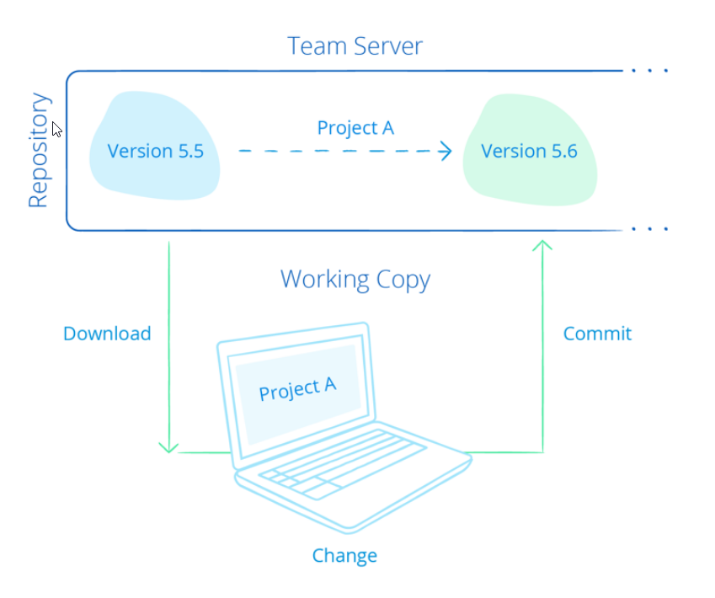
Project Update

Slide 4
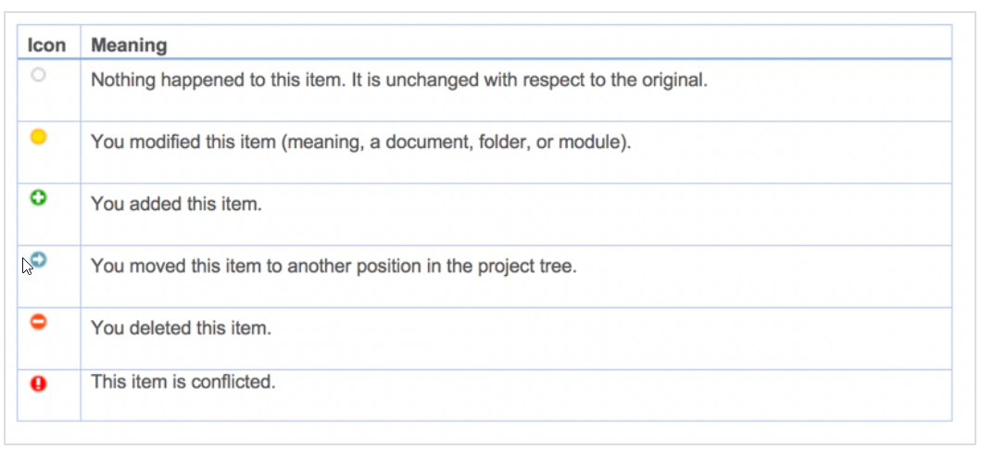
You can see all the changes made to the Working Copy in the Changes view at the bottom of the modeler as well as in the Project Explorer. If you right-click a change in the Change view, you can go to the change.

Slide 5
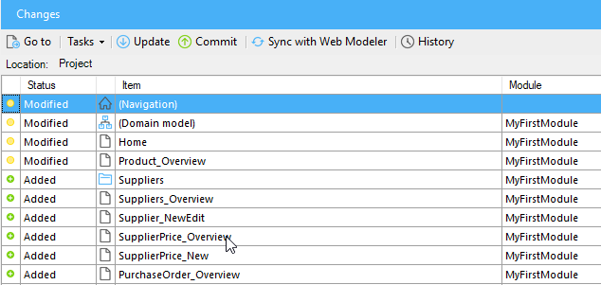
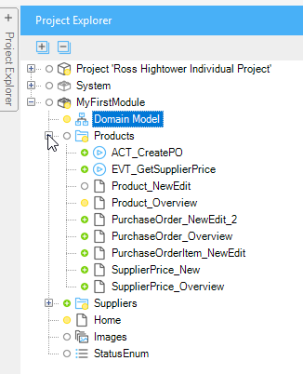
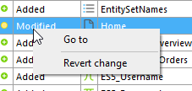
You can revert any changes by right-clicking the change in the Change view

Slide 6
Committing transfers changes to the repository and creates a new version. It also attaches additional information:
The author (the user who committed)
The date and time of the commit
The list of changed content (documents/folder/modules), along with the type of the change (modify, add, delete, etc.)
The version of the Modeler that was used to commit
You must include a commit message that describes the types of changes it includes
Normally, you should do frequent, small commits to the repository

Slide 7
Committing is only possible if the Working Copy is up to date with the repository.
If another team member has committed since you updated the Working Copy, you have to update again which will merge the changes in the new version from the repository with your Working Copy.
This update happens automatically when you commit.

Slide 8
Version 40
Version 41
Version 42
Version 43
Version 44
New version contains your changes along with all the changes added by others since Version 40
Update
and
merge
Working Copy
Changes to Working Copy
Commit
Conflicts can occur if changes in the repository and working copy are similar. If so, you will have to resolve the conflicts by choosing which
to keep.

Slide 9
Development Lines
A repository can contain multiple development lines which can be developed independently of one another. By default, there is one line called the Main Line.
Main Line
1
2
3
4
5
For example, you can keep the Main Line to fix bugs in a deployed system and create a second (branch) line for feature development.
Branch Line
3
4
6
1
2
5
Main Line

Slide 10
Merging
You merge a line in the repository into the Working Copy so you should commit any changes in the Working Copy before merging.
Branch Line
3
4
7
merge
1
2
5
6
Main Line

Slide 11
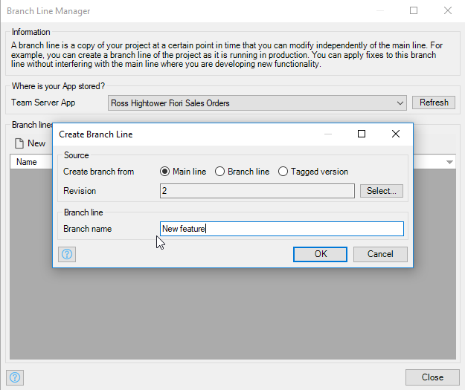
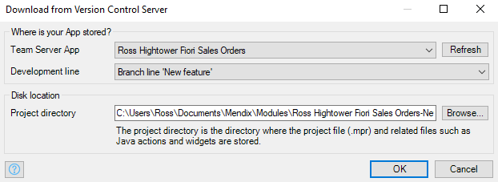
Create a branch…
… and you will be prompted to download it

Slide 12
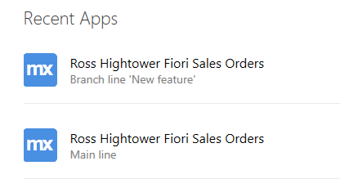
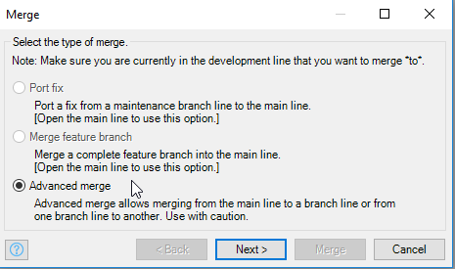
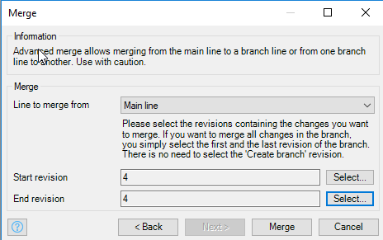
Different branch lines are shown on the list of apps
You can also reverse a merge

